Slide 1
Steam Games Dataset
BA305 B8 Team 8 By Elmir Shabayev, Daniel Wu, Naser Salas

Slide 2




Meet the Team
Daniel
Naser
Elmir

Slide 3

Problem: Predicting positive rating based on steam page features
Steam is an online game distribution platform where video game developers submit their projects for players to enjoy.
As video game developers, we want to find what could influence the reception of the video game from the catalogue of features Steam allows developers to describe/include on the page

Slide 4
Dataset Overview
Predictive Variable
Positive% (Percentage of positive reviews over total number of reviews)
Columns: 39
Ex: Name, Release Date, About the game
Rows: 96000+
Each row represents a game and its features

Slide 5
Iteration 1 - Data cleaning netted no predictive power
Notes Encoding
Pruning Sparse Features
Dummy Variables
Converted notes to binary (0 = no notes, 1 = note present)
Categories/Genres: Drop the values below the mean frequency
Kept only “Tags,” with greater than 10,000 entries
Created dummy variables for all categorical variables within language
Kept the top 10 languages used in all games

Slide 6
Data Composition and Cleaning Iteration 1
Raw Dataset - 39 Columns
Iteration 1 - 75 Columns
Benchmark RMSE: 24.89
Model 1 | KNN Regressor | RMSE: 23.65
Model 2 | Decision Tree | RMSE: 32.70
Model 3 | Random Forest | Best RMSE: 22.94
Model 4 | Linear Regression | RMSE: 23.55
Model 5 | Neural Network | RMSE: 23.37

Slide 7
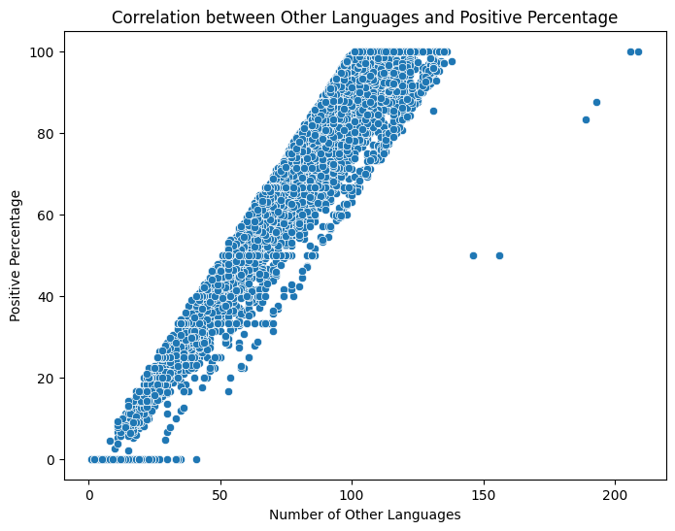
Iteration 2 - Other languages unreliably improves model performance
Initial Language Encoding
One-Hot-encoded top 10 languages
Combined the rest into an “Other Languages” Column
97.5% Feature importance (Random Forest)
Although other languages seems highly correlated, this shouldn’t discount other features that may affect a games reception

Slide 8
Data Composition and Cleaning Iteration 2
Iteration 1 - 75 Columns
Iteration 2 - 76 Columns
Benchmark RMSE: 24.62
Model 1 | KNN Regressor | RMSE: 15.27
Model 2 | Decision Tree | RMSE: 2.32
Model 3 | Random Forest | RMSE: 22.94
Model 4 | Linear Regression | RMSE: 2.02
Model 5 | Neural Network | Best RMSE: 1.49

Slide 9
Iteration 3 - AI generated columns do not have enough variance to improve predictions
Chat GPT Generated Features
Transformations
Scored “About the game” and “Notes” text quality (0-10) scale
Create new game-level features:
Development time, Game Budget (AAA/AA/Indie), Estimated runtime, Ad Quality, Controller support, Difficulty
Aggregated publisher/developer experience into total game count
Language Aggregation
Categorical Features
Introduced “total languages,” by summing all languages
Removed “other languages” in favor of this
Extracted “Season,” from release month and calculated “Years Old,” from release year
Counted values in Categories, Genres, Tags, Supported languages, and Audio languages
One hot encoded Game Budget, Difficulty, Season

Slide 10
Data Composition and Cleaning Iteration 3
Iteration 2 - 75 Columns
Iteration 3 - 53 Columns
Benchmark RMSE: 24.64
Model 1 | KNN Regressor | RMSE: 23.68
Model 2 | Decision Tree | RMSE: 32.50
Model 3 | Random Forest | Best RMSE: 22.72
Model 4 | Linear Regression | RMSE: 23.61
Model 5 | Neural Network | RMSE: 23.13

Slide 11
Iteration 4 - Searched for additional datasets with promising features to improve predictions
Merge Datasets and Keep Key Features
Final Transformation
Retained High-Importance Features, “Notes Quality,” and “About the Game Quality,” (0-10) scores from ChatGPT
Dropped other Chat GPT features due to low accuracy
External Dataset Attempts
Dataset 1: Had repeated game names, reduced to 5,000 rows after grouping → not merged
Dataset 2: No matching names with our dataset → not used
Dataset 3: Successfully merged
Used review stats + Chat GPT-rated short and detailed descriptions (0–10)
One-hot-encoded: Estimated owners and seasons
Dropped redundant Features
Ensure no duplicate rows, or missing values remained
Removed original text columns (short_description, detailed_description, about_the_game) after extracting Chat GPT scores

Slide 12
Data Composition and Cleaning Iteration 4
Iteration 3 - 53 Columns
Iteration 4 - 49 Columns
Benchmark RMSE: 24.04
Model 1 | KNN Regressor | RMSE: 21.64
Model 2 | Decision Tree | RMSE: 26.62
Model 3 | Random Forest | Best RMSE: 18.65
Model 4 | Linear Regression | RMSE: 21.52
Model 5 | Neural Network | RMSE: 18.81

Slide 13
Data Composition and Cleaning Summary
Raw Dataset - 39 Columns | ————> | Iteration 1 - 75 Columns | Best RMSE: 22.94
Iteration 1 - 75 Columns | ————> | Iteration 2 - 76 Columns | Best RMSE: 1.49
Iteration 2 - 75 | ————> | Iteration 3 - 53 | Best RMSE: 22.72
Iteration 3 - 53 | ————> | Iteration 4 - 49 | Best RMSE: 18.65

Slide 14

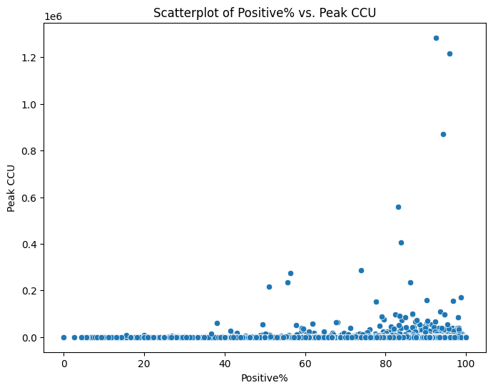
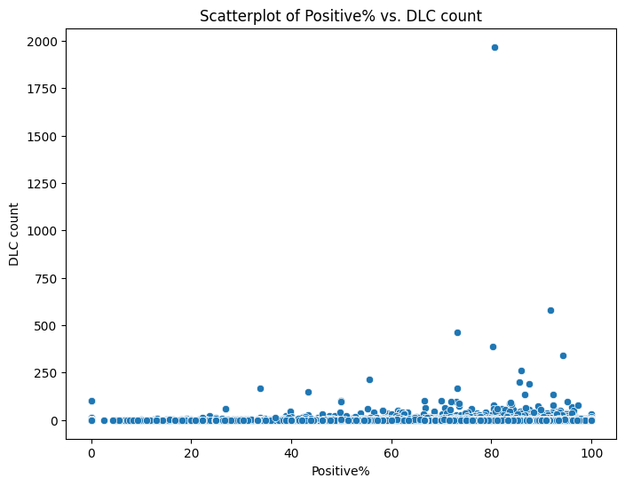
Many original columns in dataset has low variance leading to low predictive powers

Slide 15

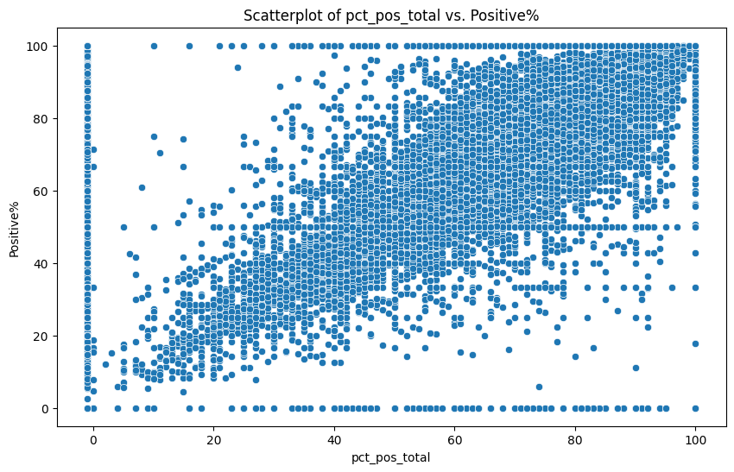
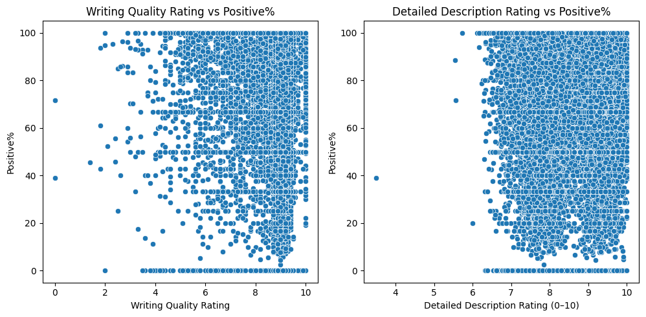
Generated and added columns from other datasets have more variance, results more predictive power

Slide 16

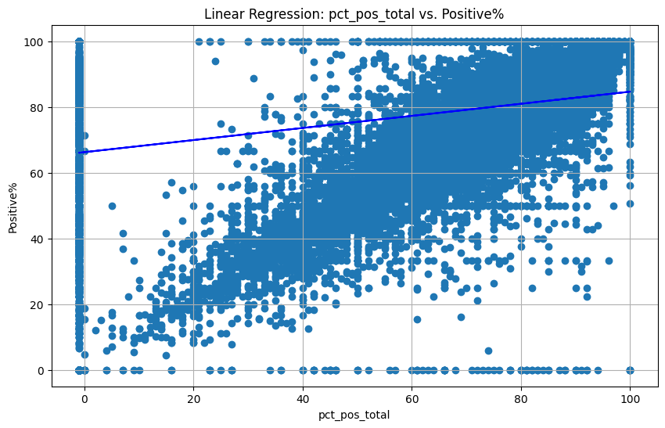
Linear regression does not align feel with the dataset
Conducted Cross Validation and found the average score.
Relationship between features and response variables is not linear which is why RMSE is not decreased much.
Benchmark RMSE: 24.04 | Average CV RMSE: 21.92

Slide 17

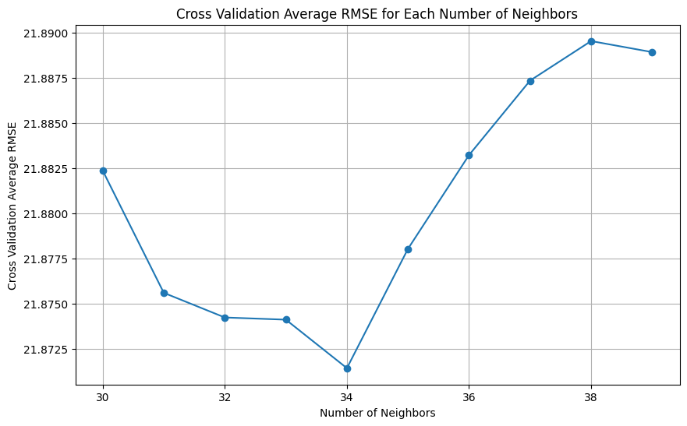
KNN Regressor improved with more neighbors up to a point
We used increments of 10 for num_neighbors and checked the CV score
The best number of neighbors we found is 34.
Benchmark RMSE: 24.04 | Tuned Parameter Result - CV AVG RMSE: 21.87
N-Neighbors: 34

Slide 18

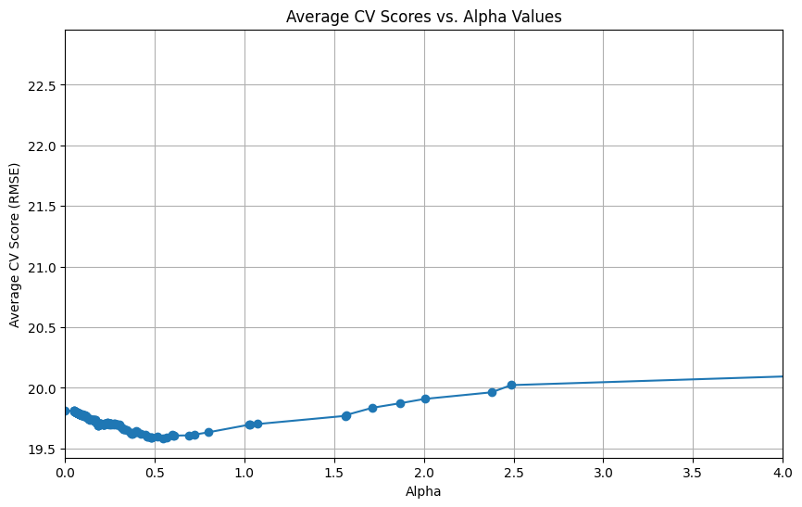
Decision tree tuning greatly improves model performance
Tuned the parameters with GridSearch and found the combination with least CV score.
Pruned the tree until we found the an alpha with the least CV score.
Benchmark RMSE: 24.04 |  | Tuned Parameter Result - CV AVG RMSE: 19.5
Max Depth: 10 | Min Impurity Decrease: 0.05 | Min Samples Leaf: 8 | Min Samples Split: 20 | Alpha: 0.55

Slide 19
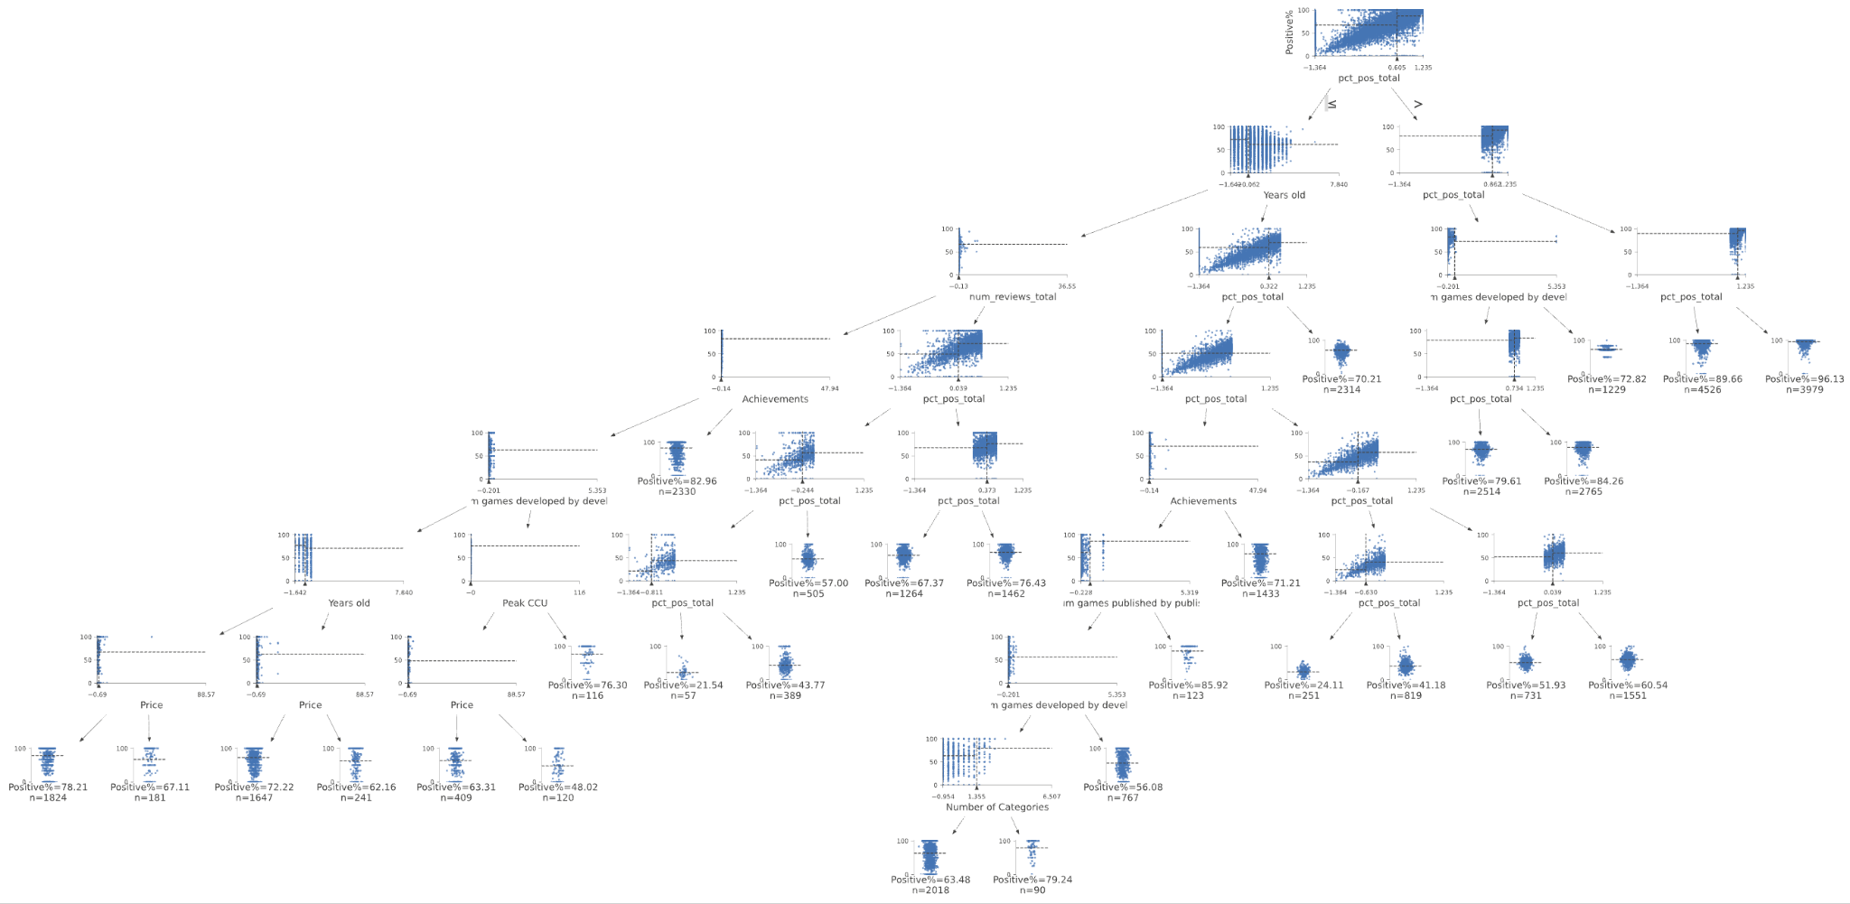
Final Decision Tree: Interpretable

Slide 20

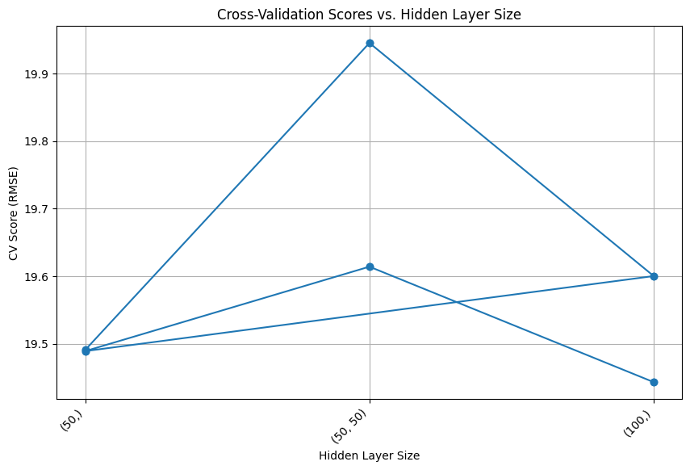
Neural networks performs well but limited by computational intensity
Grid Search to find best parameter combination.
Neural Network achieved second lowest CV average.
Limited tuning because models take long to run.
Benchmark RMSE: 24.04 | Tuned Parameter Result - CV AVG RMSE: 19.44
Activation: Logistic | Alpha: 1 | Hidden Layer Size: 100 | Learning Rate: Constant

Slide 21

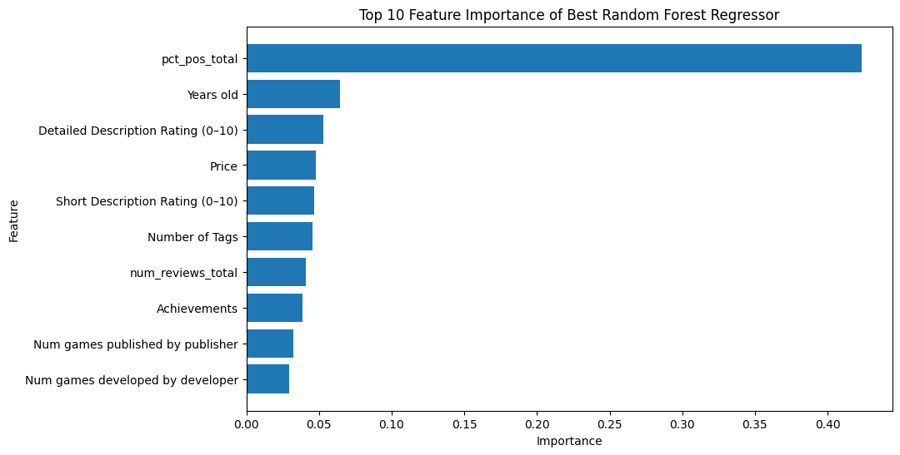
Random forest performed the best due to robustness
Again, GridSearch to find optimal combination of parameters.
Computational limits forced us to run 3 tuning models with different parameter values.
The new features we added have high importance.
Benchmark RMSE: 24.04 | Tuned Parameter Result - CV AVG RMSE: 19.00
Max Depth: 15 | Max Features: 0.5 | Min Sample Leaf: 3 | Min Sample Split: 5

Slide 22

Challenges
Dataset Cleaning and Feature Engineering
Limited hyper-parameter testing
Cross-Validation presented challenges in Model evaluation

Slide 23

Conclusion
Chosen Model: Decision tree
While not most accurate, Decision Trees provide an advantage in interpretability. However, all model results are still not good.
Steam page features do not have significant predictive power to determine a games reception
Game developers should prioritize gameplay features and factors that are unique to each game’s design to improve reception or performance.

Slide 24


Future Changes
Explore additional datasets with columns related to development strategies and production costs
Drop rows with excessive 0 values in key columns to reduce noise and increase model accuracy

Slide 25


